Slide 1
UHV-I Session 6 Resolution of Concerns at the Individual Level
Developing self-confidence, overcoming peer pressure…

Slide 2
Interaction Before Main Session
Hear from participants about their exploration from previous day(s)
Q&A
Place some expected conclusions, find out if they also came to these/similar conclusions

Slide 3
Home Assignment
5.1. Could you see that you have two types of needs:
A continuous need (like the need for respect) – need of the Self
A temporary need, which is required from time to time (like the need for food) – need of the Body
5.2. Look into your list of aspirations. Classify it into 2 categories – aspirations related to the Body (like food) and aspirations related to the Self (like name and fame). Which aspirations are prominent – aspirations related to the Self or aspirations related to the Body? Reflect on how you are trying to fulfil the needs related to the Self. What is your takeaway from this exploration?
5.3. Can you see you have an inherent faculty of natural acceptance? Is it always for harmony, for relationship?
5.4. Can you see that something is going on in your imagination? Can you see that when you have a feeling that is naturally acceptable to you, you are in harmony, happy?
5.5. Is the program for fulfilment of your aspirations and resolution of your concerns at the individual level clearer through this exploration? Discuss the program with your batchmates

Slide 4
UHV-I Session 6 Resolution of Concerns at the Individual Level
Developing self-confidence, overcoming peer pressure…

Slide 5
Introduction
In the previous lecture, we saw that human being is the co-existence of Self and Body.
When the imagination is guided by natural acceptance, it is in harmony, happiness
In this lecture, we will explore three sources of imagination
We will see that our concerns, like peer pressure, overthinking, procrastination, addiction, etc., arise when the imagination is not guided by natural acceptance
Our concerns are resolved when our imagination is in line with our natural acceptance

Slide 6
Recalling: Activities of the Self
Natural Acceptance
To be happy
To be prosperous
To have health in the body
To have the feeling of relationship
Dialogue?
Self
Imagination
I expect to be respected…
I think I am special…
I desire to be a billionaire…
I feel like taking revenge…
Co-existence
Body
Behaviour O;ogkj
Work dk;Z
Notes:
The Self can be recognized in terms of its activity
We can see the activity of imagination… try it now – what is going on? All the time or only sometimes (keep it open)?
Reinforce - Behaviour and work are only expressions of imagination
Every Self has a natural acceptance
(E.g., We have a natural acceptance for the feeling of relationship… not for opposition)
The natural acceptance is a glimpse of the higher possibility in the Self, a glimpse of what I really want to be
Natural acceptance is definite, uncorrupted, universal…
5. The dialog that we started between me and you will soon begin within you – a dialogue beween your imagination and your natural acceptance

Slide 7
Activities of the Selfa
1.
2.
3. | Desire bPNk
4. | Thought fopkj
5. | Expectation vk'kk
Activity fØz;k
Imaging fp=.k
Analysing-Comparing fo'ys"k.k&rqyu
Selecting-Tasting p;u&vkLoknu
Self eSa
Natural Acceptance
Imagination
dYiuk”khyrk
Imagination
(Desire, Thought, Expectation)
Information
Body 'kjhj
Behaviour O;ogkj
Work dk;Z
Notes:
The Self can be recognized in terms of its activity
We can see the activity of imagination – our (desire, thought, expectation)
Reinforce - Behaviour and work are only expressions of imagination - the Self instructs the Body and it does
The only transaction between the Self and the Body is in the form of information
We can observe our imagination – try it now – what is going on?

Slide 8

Sources of Imagination
1.
2.
3. | Desire bPNk
4. | Thought fopkj
5. | Expectation vk'kk
Activity fØz;k
Imaging fp=.k
Analysing-Comparing fo'ys"k.k&rqyu
Selecting-Tasting p;u&vkLoknu
Natural Acceptance
lgt Loh—fr
Self eSa
3
Self-organized Lora=rk √
Preconditioning ekU;rk
Content of Imagination
dYiuk”khyrk
dh oLrq
1
Enslavement ijra=rk X
Information
Body 'kjhj
2
Sensation laosnuk
Enslavement ijra=rk X
Behaviour O;ogkj
Work dk;Z
Notes:
Imagination may be motivated by sensation, preconditioning or NA (these are 3 possible sources of motivation for imagination)
Give small examples of each source of motivation
It is important to note that we are trying to communicate
Self is in harmony with the portion of imagination that is in line with Natural Acceptance (NA). We have to increase that % to 100%...
Preconditioning = Assuming without Knowing. We have to evaluate our preconditioning – if it is in line with NA, it will become part of our right understanding; if it is not in line with NA, it will drop. In this way we have to get rid of 100% of the preconditioning.
We don’t have to get rid of all Sensation - We only have to make right use of Sensation (e.g., for the health of the Body). If we are trying to derive happiness out of the sensation, then we have to get rid of it (by moving to the right source of happiness)

Slide 9
Examples: Preconditioning, Sensation and Natural Acceptance
Natural Acceptance
Food for health
Food for taste
Food for show off
Mobile for communication, knowledge
Mobile for entertainment
Mobile for status
See note also
Sensation
Preconditioning
Natural Acceptance
Sensation
Preconditioning
Notes:
It is important to note that we are trying to communicate
Self is in harmony with the portion of imagination that is in line with Natural Acceptance (NA). We have to increase that % to 100%...
Preconditioning = Assuming without Knowing. We have to evaluate our preconditioning – if it is in line with NA, it will become part of our right understanding; if it is not in line with NA, it will drop. In this way we have to get rid of 100% of the preconditioning.
We don’t have to get rid of all Sensation - We only have to make right use of Sensation (e.g., for the health of the Body). If we are trying to derive happiness out of the sensation, then we have to get rid of it (by moving to the right source of happiness)

Slide 10
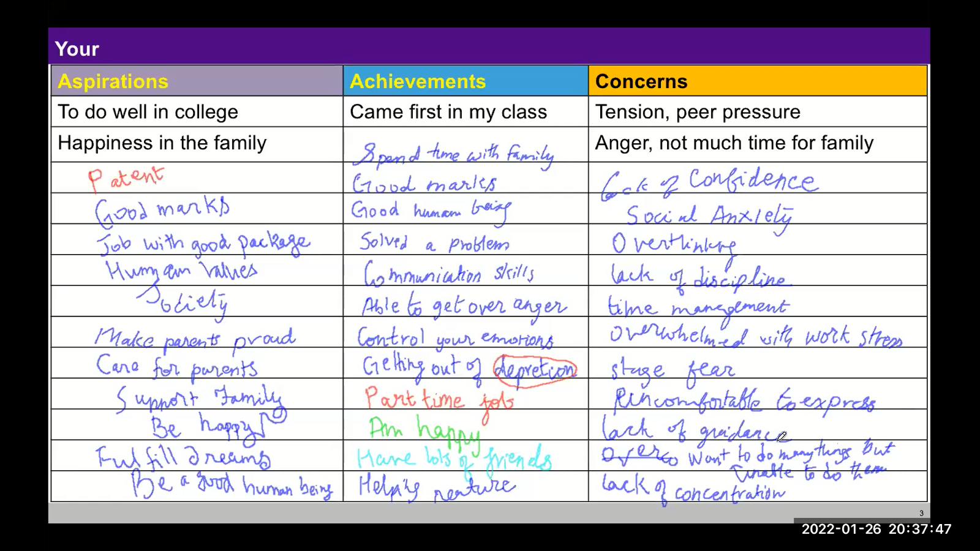
Enslavement of Preconditionings, Sensations
Outcome
Money is everything
Success is getting ahead of others
Speaking in a particular language fetches respect
Freedom is using foul language
Exclusive clothes needed to be center of attraction
Show-off is needed to survive in the society
Latest gadgets are status symbols
If I don’t do like others, I will be isolated, left behind
You have to be selfish to survive
No one is trustworthy
The list could be much longer…
These become our concerns

Slide 11
Exercise
From your list of your concerns, pick one concern
Find out the preconditioning or sensation that is underlying that concern
Then find out what is a naturally acceptable to you
We will explore if this provides a resolution for that concern
Let us take a common concern as an example
Notes:
We will explore if this provides a resolution for that concern

Slide 12

Concern
Underlying Preconditioning
Peer pressure
e.g., I will be accepted by peers only if I…
Speak in a particular language (it will fetch respect)
Use foul language (it is needed to fit into this circle)
Wear fashionable clothes (then I will be like them)
Eat and drink like them (so they will not think I am different)
Be extravagant (it is essential to keep up to their ‘standard’)
…
Check: By living according to these preconditionings, is it definite that you will be happy?
And can it ensure the continuity of happiness?

Slide 13
Resolution of Concern regarding Peer Pressure
Paying attention to the Natural Acceptance
Developing right understanding about human being leading to clarity about Self and Body
(need of Self, need of Body, sources of imagination…)
Developing right understanding about relationship leading to right feeling
(trust, respect…)
With right understanding, we are able to see trust as the foundation of every relationship
(and similarly we are able to ensure other feelings)
This understanding helps us come out of peer pressure (and resolve many other such concerns)
We will discuss about relationship in session 8

Slide 14

Imagination not completely in line with Natural Acceptance → Partial harmony in the Self
 |  | Activity fØz;k
1. |  | Realization vuqHko
2. |  | Understanding cks/k
3. | Desire bPNk | Imaging fp=.k
4. | Thought fopkj | Analysing fo'ys"k.k
5. | Expectation vk'kk | Selecting/Tasting p;u@vkLoknu
Natural Acceptance
INTENTION
What I Really Want to Be
3
Preconditioning
ekU;rk
1
COMPETENCE
What I Am
Harmony?
Contradiction?
Information
Body 'kjhj
2
Sensation
Lakosnuk
Behaviour O;ogkj
Work dk;Z
Notes:
Generally, all three sources motivate my imagination
The yellow part is my competence – that matches with my NA (my intention); the rest may or may not match

Slide 15
Imagination completely in line with Natural Acceptance → Complete Harmony in the Self
 |  | Activity fØz;k
1. |  | Realization vuqHko
2. |  | Understanding cks/k
3. | Desire bPNk | Imaging fp=.k
4. | Thought fopkj | Analysing fo'ys"k.k
5. | Expectation vk'kk | Selecting/Tasting p;u@vkLoknu
Right Understanding
in the Self
Natural Acceptance
INTENTION
What I Really Want to Be
Happiness
= To be in a state of Harmony
Lkq[k
¾ laxhr esa] O;oLFkk esa thuk
Guiding
Content of imagination
In harmony
COMPETENCE
What I Am
Information
Body 'kjhj
Behaviour O;ogkj
Work dk;Z

Slide 16
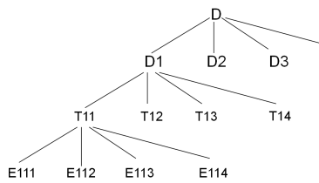
Partial harmony in the Self Complete Harmony in the Self
Imagination partially guided by natural acceptance
Imagination may be disorganised, random
Sometimes happiness, sometimes unhappiness
Imagination fully guided by natural acceptance
Imagination is fully self-organised
Continuity of happiness
Harmony?
Contradiction?
Harmony
🥳 Excitement…
😊 State of harmony
😣 Depression…

Slide 17
Sum Up
Imagination may be motivated by preconditioning, sensation or natural acceptance
When imagination is fully guided by natural acceptance, the Self is in harmony; and there is continuity of happiness
When the imagination is coming from preconditioning or sensation, it is unclear if one is in a state of happiness or unhappiness. In such a state, one may succumb to preconditionings, get carried away by sensation, and have multiple unresolved concerns
The state of the self is largely dictated by external influences
One is enslaved (परतंत्र) by one's own preconditionings, sensation
In this state, the conduct is indefinite (it may be human or inhuman)
By making effort for right understanding, one can ensure the right feeling within, be free from enslavement, be self-organized (स्वतंत्र) and be in a state of continuous happiness
In this way, our concerns get resolved naturally

Slide 18
Home Assignment

Slide 19
Home Assignment
6.1. Take your list of concerns at individual level
For each concern, find out the preconditioning or sensation that is behind that concern
Then find out what you need to understand to resolve your concerns
As we cover more content, keep exploring the possible resolution of each concern
Notes:
We will explore if this provides a resolution for that concern

Slide 20
Questions

Slide 21
Enslavement of Preconditionings, Sensations
Outcome (use for faculty only)
Money is everything
Human being is merely the body
Success is getting ahead of others
Speaking in a particular language fetches respect
Freedom is using foul language
Exclusive clothes needed to be center of attraction
Show-off is needed to survive in the society
Latest gadgets are status symbols
If I don’t do like others, I will be isolated, left behind
Struggle for survival, survival of the fittest
You have to be selfish to survive
Eat drink and make merry
Make money and have fun
No one is trustworthy
The list could be much longer…
Peer pressure
Stress
Procrastination
Wastage of time
Indulgence
Addiction
Extravagance
Poor health
Domination
Fear
Anger
Over thinking
Negative thinking
Depression
Self harming
Suicidal thoughts…
These become our concerns

